Slide 1


LESSON 3 - GOD MADE THE BRIGHT SUN
1 / 13
Wave hello • Point to your friends • Cup your ear and listen
LITTLE SEEDS! MONTH 1

Slide 2

2 / 13
MEET THE SUN
Sun
Point up • Say “Sun” • Cover your eyes playfully
LITTLE SEEDS! MONTH 1

Slide 3

3 / 13
THE BLUE SKY
Sky
The sun is in the sky. Sweep your arms wide overhead!
LITTLE SEEDS! MONTH 1

Slide 4
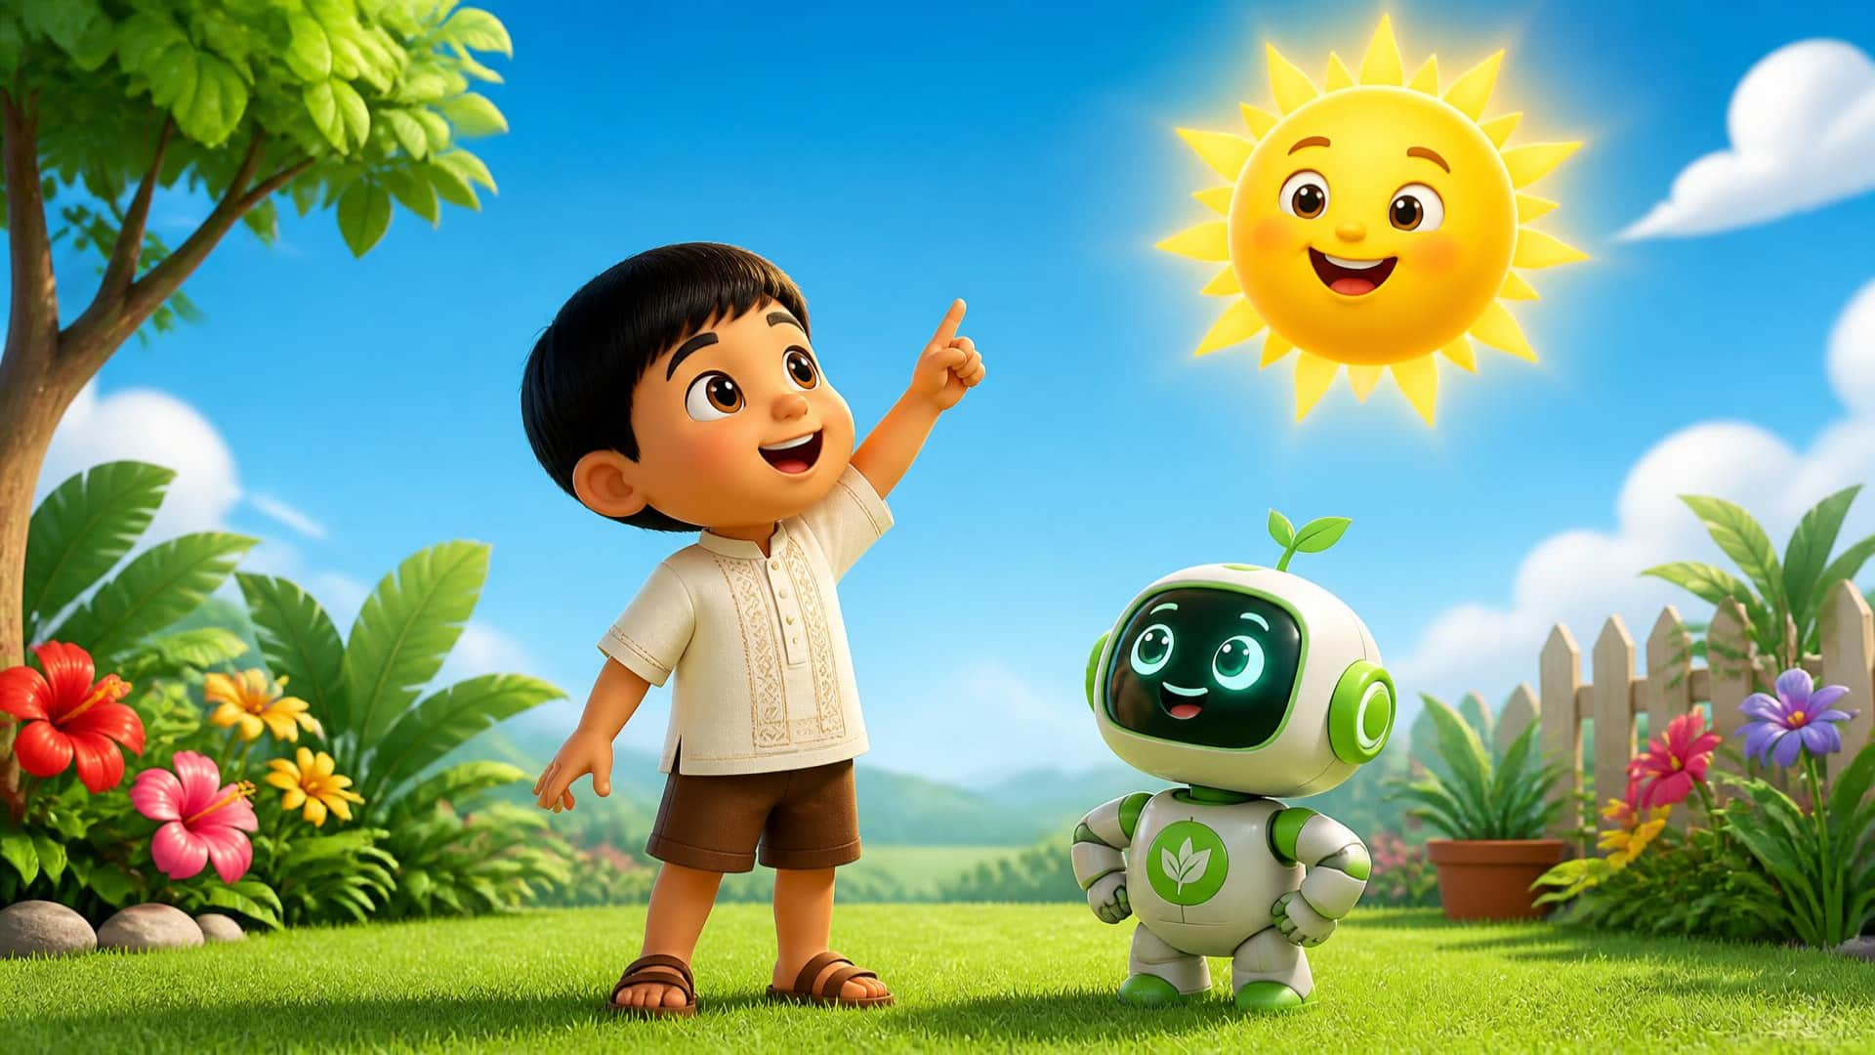
4 / 13
LET’S MOVE
Up, up, up!
Point down, then point UP • Say it together!
LITTLE SEEDS! MONTH 1

Slide 5
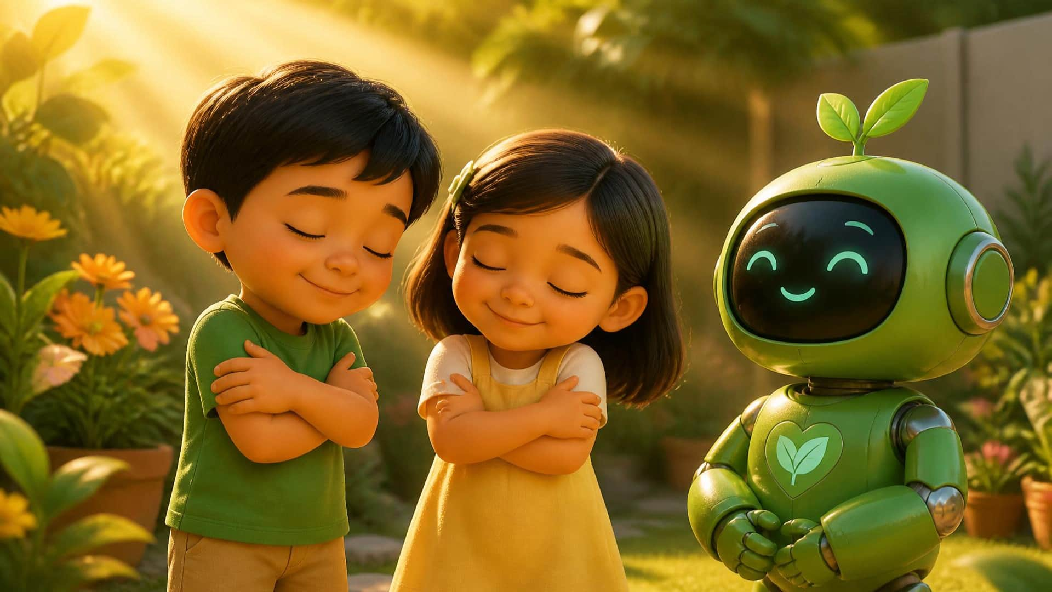
5 / 13
FEEL THE SUN
Warm
Hug and rub your arms gently • Say “Warm”
LITTLE SEEDS! MONTH 1

Slide 6
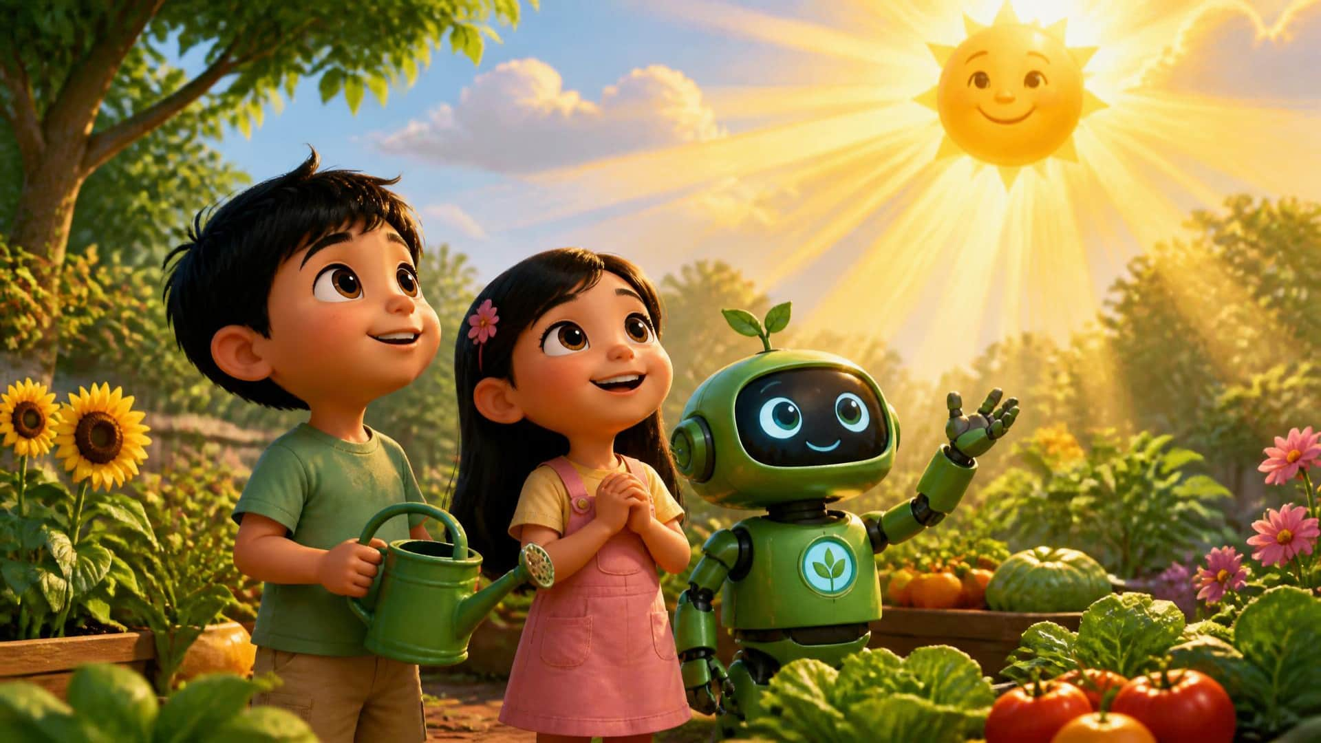
6 / 13
GOD’S WONDERFUL WORLD
God made the sun.
Point up with wonder • Say the sentence together
LITTLE SEEDS! MONTH 1

Slide 7






7 / 13
A THANKFUL HEART
Thank you, God!
Hands on your heart • Clap gently • Say thank you
LITTLE SEEDS! MONTH 1
RemovalPH

Slide 8

8 / 13
SUNSHINE GAME
Where is the sun?
Touch the sun! Great looking!
LITTLE SEEDS! MONTH 1

Slide 9
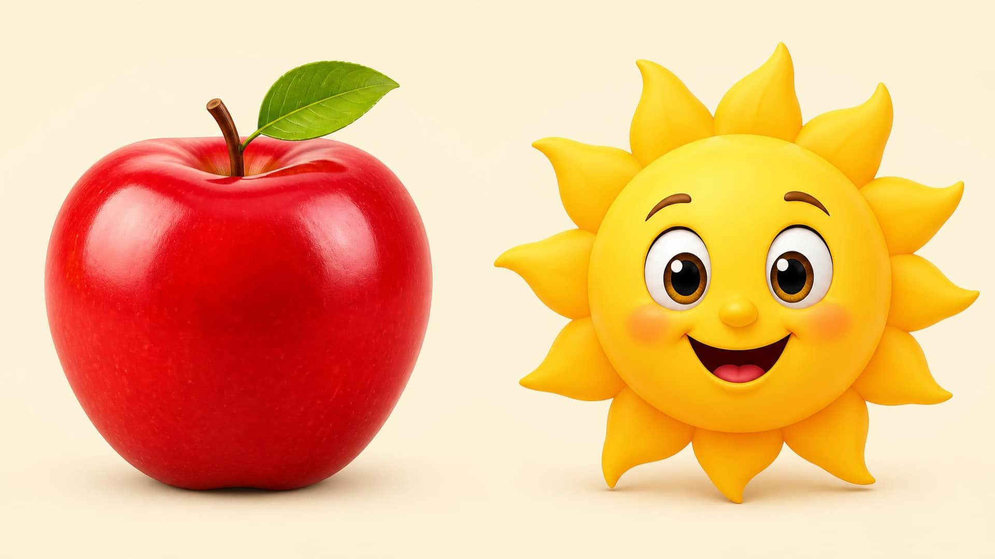
9 / 13
LOOK & CHOOSE
Sun or Apple?
Touch the apple • Now touch the sun • Well done!
LITTLE SEEDS! MONTH 1

Slide 10
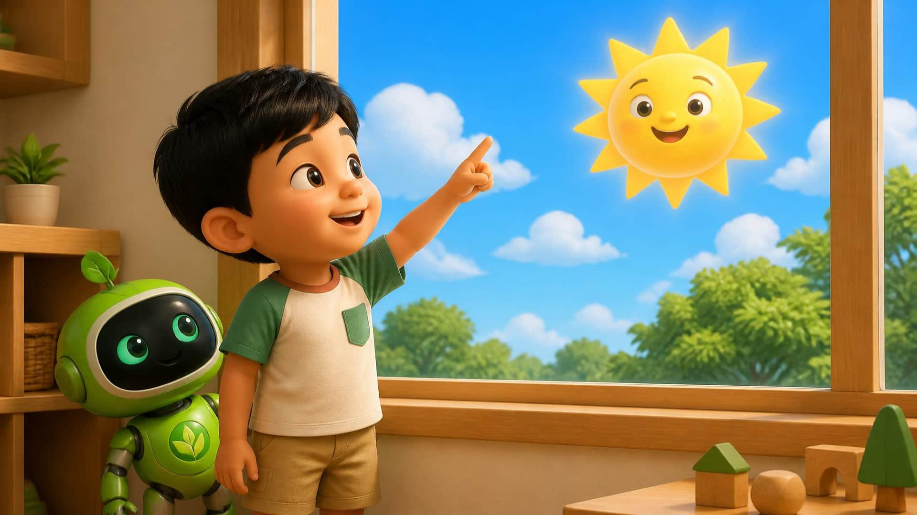
6 / 13
REAL WORLD CONNECTION
Look outside!
Can you find the sky and sun? Point up!
LITTLE SEEDS! MONTH 1

Slide 11

11 / 13
LET’S REMEMBER
Sun. Sky.
God made the sun.
Point • Say each word • Celebrate what you learned
LITTLE SEEDS! MONTH 1

Slide 12
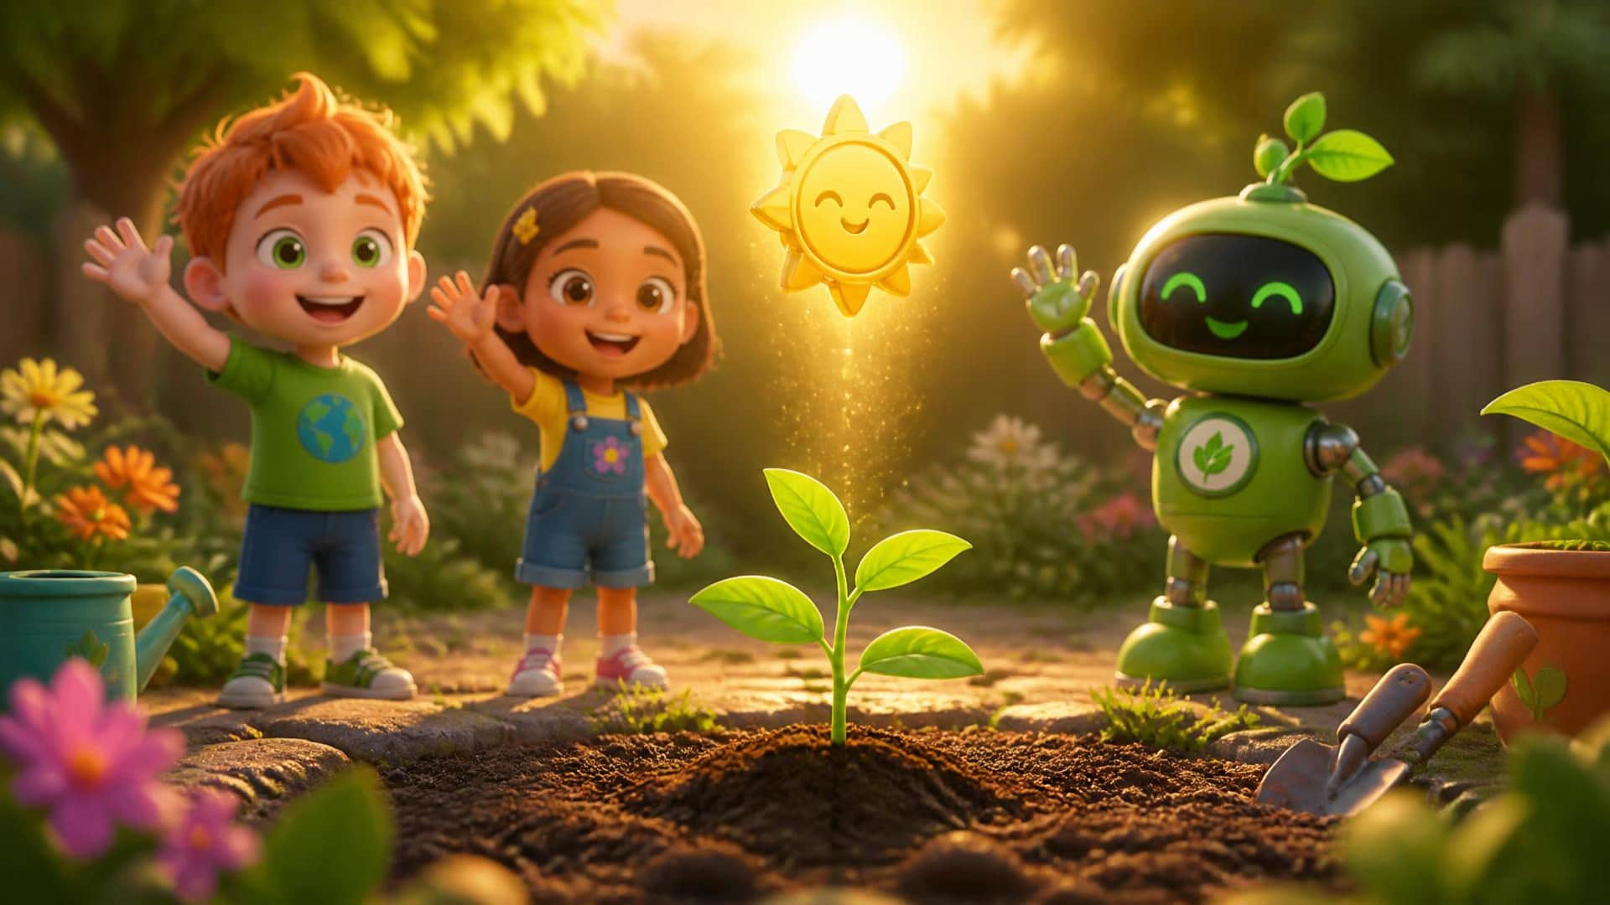
6 / 13
SUNSHINE POINT EARNED!
Goodbye!
Our little garden grows • Wave goodbye, Little Seed!
LITTLE SEEDS! MONTH 1

